Slide 1

Oat Molecular Toolbox:
Toward Better Oats
Nick Tinker, 2014-March-5
Agriculture and Agri-Food Canada
Notes:
My team works on the interface between molecular genetics and breeding.
I will be talking about our work with oat (Strong US partnership, less oat in Mexico)
Want more planned and coordinated international effort.
Mexico understands this well (CYMMYT)

Slide 2
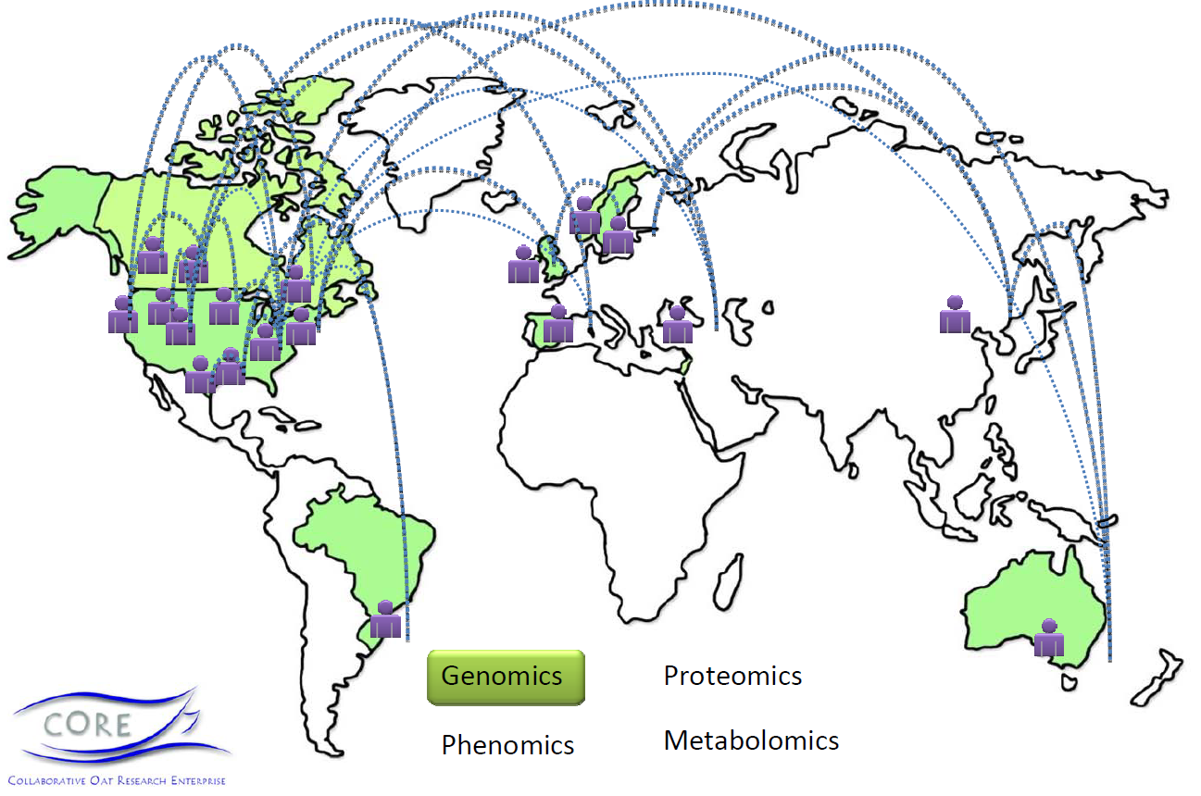

Collaborative Oat Research Enterprise
* Mexico:
Julio Huerta
Eduardo Villa senior Mir
Eduardo Espitia
Notes:
I will be drawing on results from a major International collaboration called CORE
Led by Eric Jackson (now at General Mills) and myself.
Model for meeting challenges of a public crop, industry support, International collaboration.
CORE is complete, we are integrating results into a new breeder-driven effort called EnCORE

Slide 3
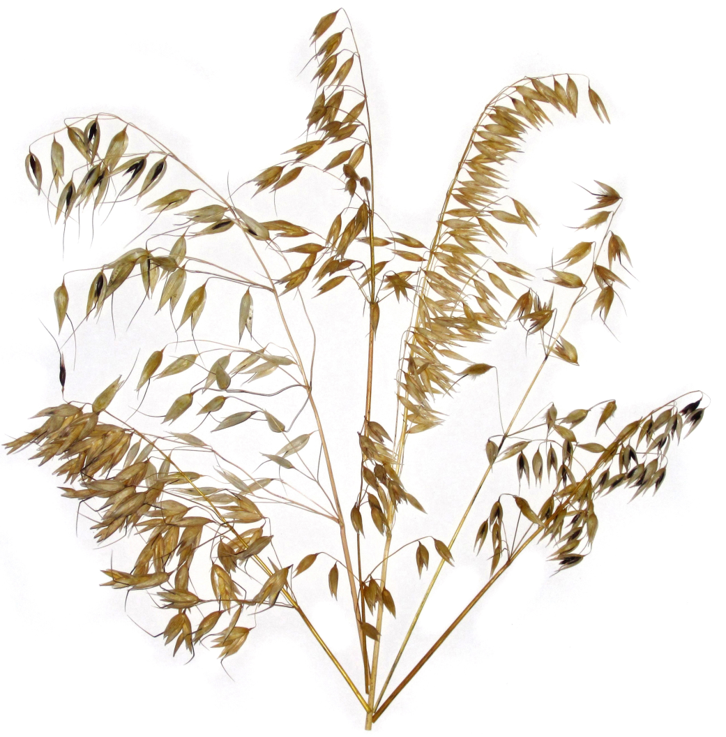
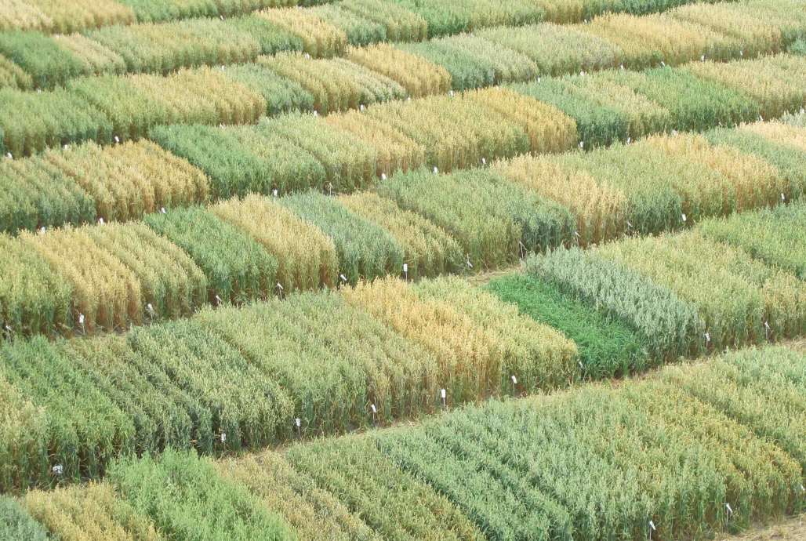
What makes oats different, which differences make a better oat ?

Slide 4
CORE Concept Summary
Representative DNA Sequence
Diverse germplasm
Discover genetic differences among oat varieties
Mapping germplasm
Marker assays
+ gene database
Breeder Germplasm
Consensus map
Genotype / Trait database
Evaluate field & seed Traits
Analyse population structure
Associate markers with traits
Breeding assays + genomic selection

Slide 5
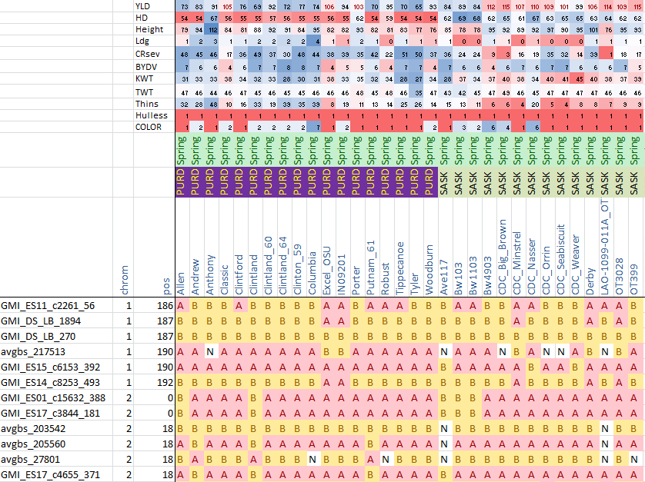

Slide 6
CORE Concept Summary
Representative DNA Sequence
Diverse germplasm
Discover genetic differences among oat varieties
Mapping germplasm
Marker assays
+ gene database
Breeder Germplasm
Consensus map
Genotype / Trait database
Evaluate field & seed Traits
Analyse population structure
Associate markers with traits
Breeding assays + genomic selection

Slide 7
This is what we were looking for
A
Allele
Functional
difference
Single Nucleotide Polymorphism
= SNP
T
SNP
= Marker
= Gene Locus

Slide 8
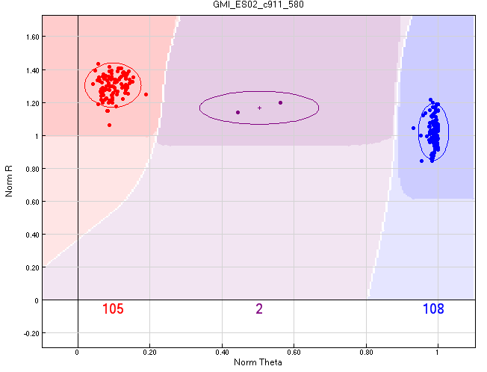
SNP assays:
GTACCATGATCGCTAACTGGCATGGCTTACGGCTTGAC
(A) ..................G...................
(B) ..................G...................
(C) ..................A...................
(D) ..................A...................
(E) ..................G...................
A SNP is a SNP …. no matter how you find it !
  “Old” non-sequence-based methods (AFLP, DArT)
  Discover by sequence / assay by design (Illumina Array) - 6000
  Discover and assay by sequencing (GBS)

Slide 9
6K SNP array annotations
38 important annotations (consolidated from many more)
SNP Locus Name
SNP Discovery method (from Table 1)
Reason for inclusion / in-silico predicted performance ª
Bead Type (1 a transition SNP, 2=transvesion SNP)
Illumina design score
Successful conversion to 6K BEAD assay
Successful assay based on MAF>0 and H<=10 in 595 progeny
SNP bases (A,T,G,C in format [A/T] )
SNP design sequence (SNP in square brackets)
Full contig sequence (for SNPs called from an assembly)
Comments made in GenomeStudio Genotyping Module
Comments made in GenomeStudio Clustering Module
Number of clusters formed in Clustering Module
Illumina Gentrain score
Non-missing calls across 1055 progeny (%)
Number of AA (alleles 1) calls in 595 breeding lines
Number of BB (alleles 2) calls in 595 breeding lines
Percentage of AB calls in 595 breeding lines
Minor Allele Frequency in 595 breeding lines
Estimated chromosome (relative to Oliver et al. 2013)
Estimated map position (cM relative to Oliver et al. 2013)
Flag=1 for framework marker (relative to Oliver et al. 2013)
Best match to Brachypodium distachyon genome
Best match to Oryza sativa genome
Best match to Hordeum vulgare genome
Best BLAST description from BLAST2GO
Minimum E value from BLAST2GO
Gene Ontology terms from BLAST2GO
Enzyme Code from BLAST2GO
Protein Accession (NCBI) from SNPmeta
Short protein name of best match from SNPmeta
Predicted SNP position in coding sequence from SNPmeta
Predicted SNP position in codon from SNPmeta
Predicted codon for allele 1 from SNPmeta
Predicted codon for allele 2 from SNPmeta
Prediction if amino acid change is silent, from SNPmeta
Predicted amino acid for SNP allele 1 from SNPmeta
Predicted amino acid for SNP allele 2 from SNPmeta

Slide 10
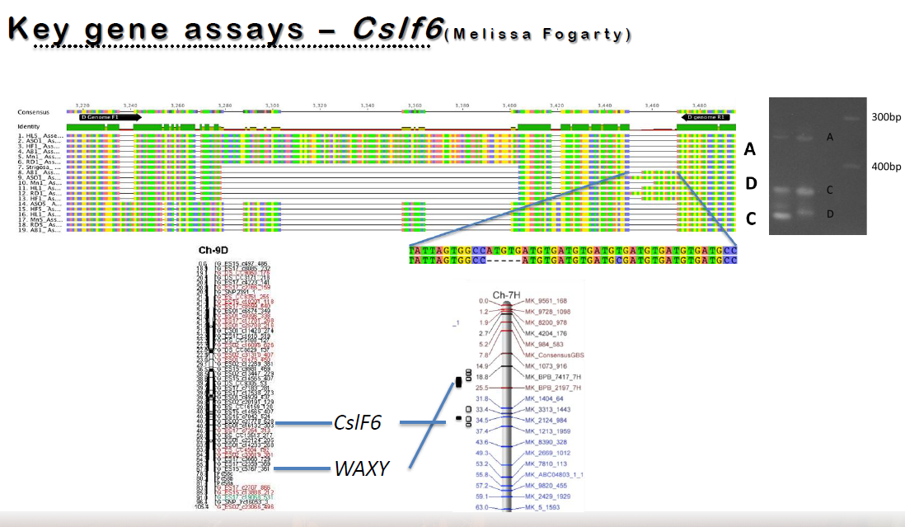
Developing functional gene assays…..
Eric Jackson et al. (unpublished)

Slide 11
CORE Concept Summary
Representative DNA Sequence
Diverse germplasm
Discover genetic differences among oat varieties
Mapping germplasm
Marker assays
+ gene database
Breeder Germplasm
Consensus map
Genotype / Trait database
Evaluate field & seed Traits
Analyse population structure
Associate markers with traits
Breeding assays + genomic selection

Slide 12
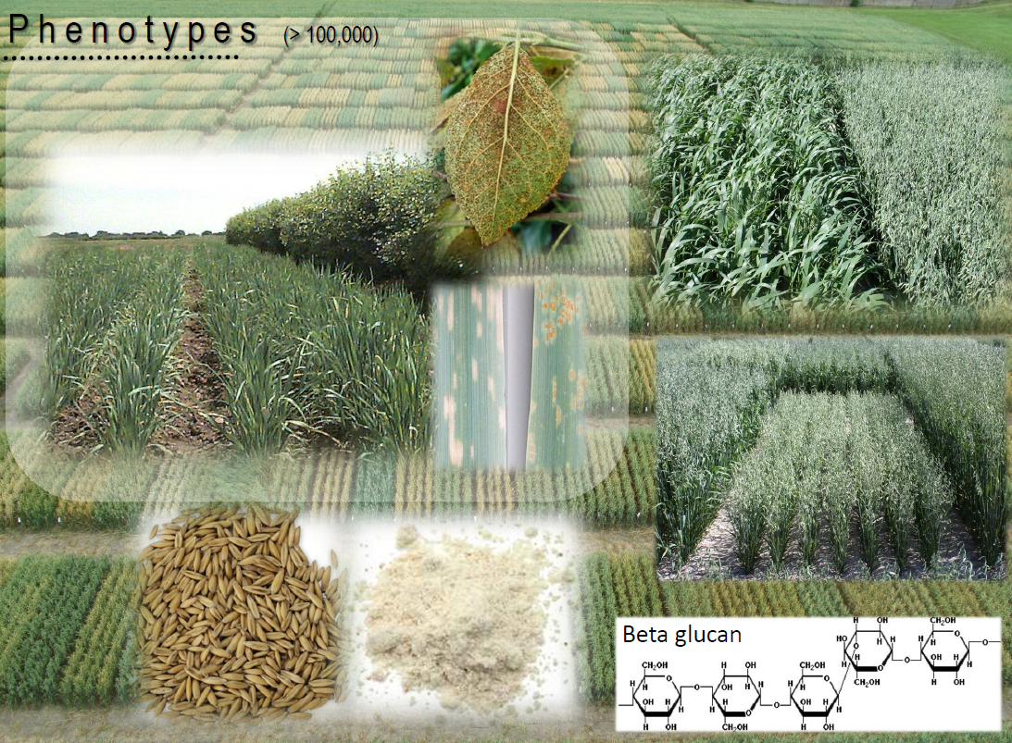

Slide 13
CORE Concept Summary
Representative DNA Sequence
Diverse germplasm
Discover genetic differences among oat varieties
Mapping germplasm
Marker assays
+ gene database
Breeder Germplasm
Consensus map
Genotype / Trait database
Evaluate field & seed Traits
Analyse population structure
Associate markers with traits
Breeding assays + genomic selection

Slide 14
The consensus map challenge
Consensus map is an abstraction
Smooth out errors in component maps
Put all markers on one map
Find ‘most popular order’ when real differences exist
Why ?
  Merge information from diverse studies
  Plan experiments
  Organize database
  Predict optimum genotypes
  Sequence genome, clone genes, perfect predictions

Slide 15
Building block populations (“component maps”)
Population | Abbr. | Pop. Size | Marker Type | Contributed by | Reference
GS-7 x Boyer | GB | 76 | 6K | Bonman et al. | Babiker et al. in press
Provena x GS-7 | PGS | 98 | 6K, GBS | Bonman et al. | Babiker et al. in press
Provena x Boyer | PB | 139 | 6K | Bonman et al. | Babiker et al. in press
86-1156 x Clintland 64 | IL4 | 112 | 6K | Kolb et al. | Foresman et al., in press
86-6404 x Clintlant 64 | IL5 | 171 | 6K | Kolb et al. | Foresman et al., in press
Assiniboia x MN841801 | AM | 161 | 6K | Mitchell-Fetch et al. | Nanjappa et al. in press
Otana x PI269616 | OP | 98 | 6K, GBS | Carson et al. | Oliver et al., 2013
CDC SolFi x HiFi | SH | 53 | 6K, GBS | Beattie et al | Oliver et al., 2013
Dal x Exeter | DE | 145 | 6K,GBS | Tinker et al. | Hizbai et al., 2012
Hurdal x Z-597 | HZ | 53 | 6K,GBS | Bjørnstad et al. | Oliver et al., 2013
Ogle x TAMO 301 | OT | 53 | 6K, GBS | Jackson et al. | Portyanko et al., 1995
Kanota x Ogle | KO | 52 | 6K, GBS | Tinker et al. | O'Donoughue et al., 1995
Notes:
Because the oat genome is so complex and its structure varies between populations a consensus of many populations would likely give a more accurate representation of the genome than any single population.
We used 12 populations to construct a consensus map that represents the 21 oat chromosomes. Those populations are shown in this table. We greatly appreciate all those who contributed their populations making this possible.

Slide 16
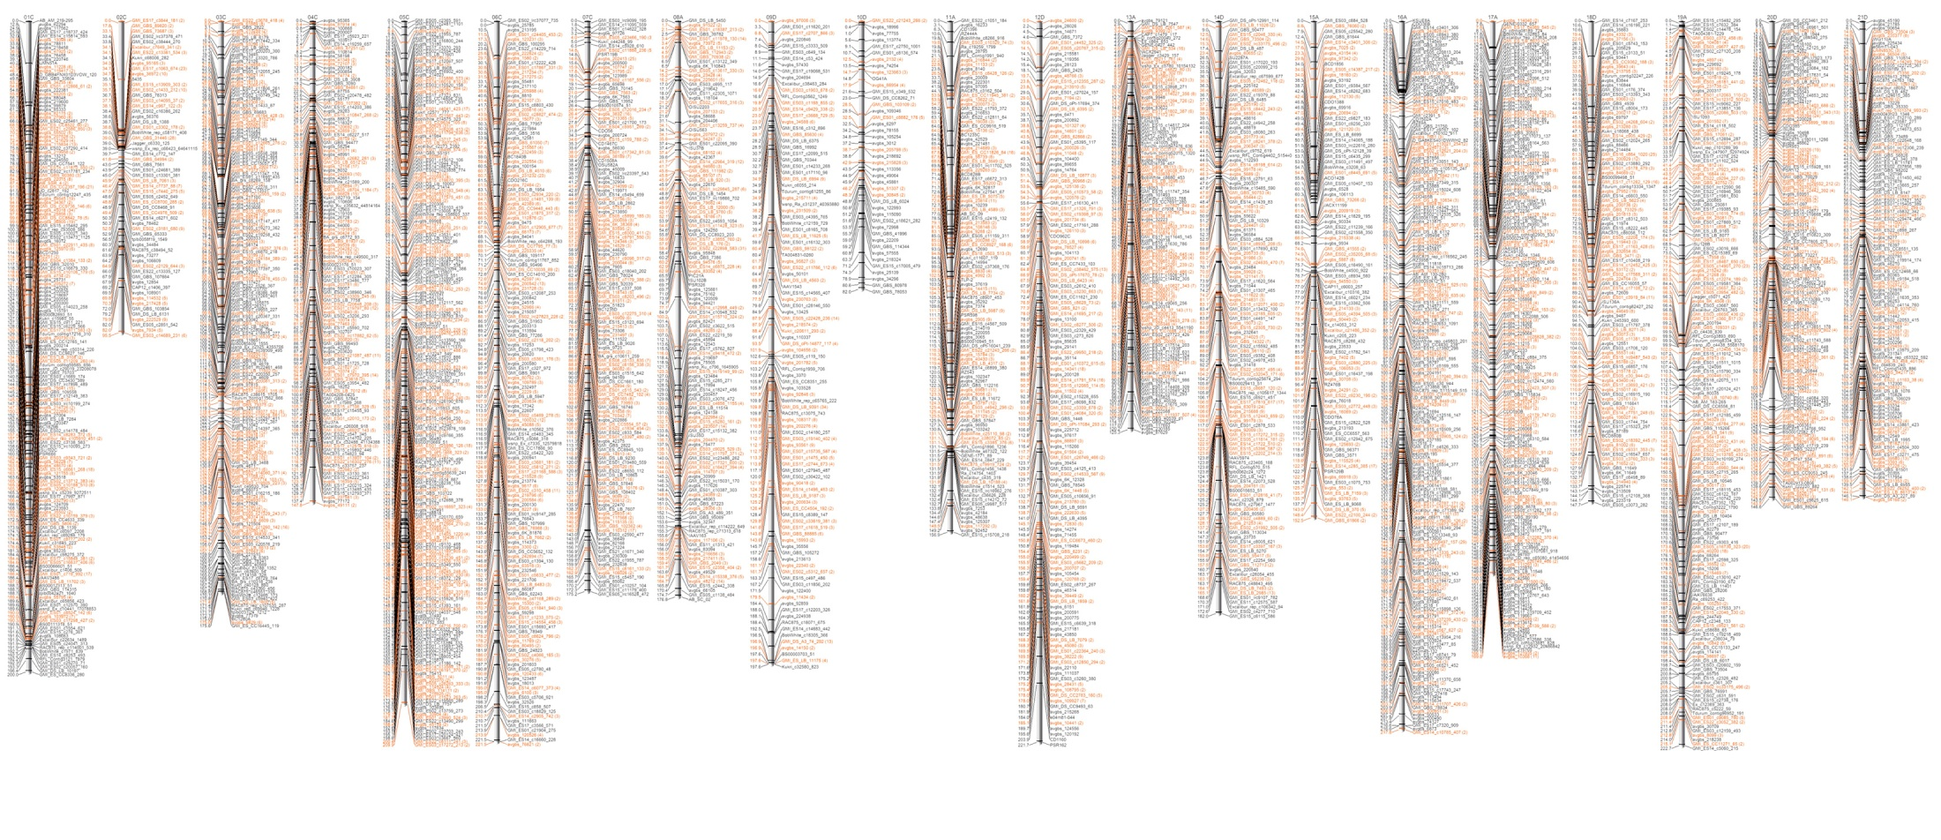
High Density Hexaploid Oat Map
1C 2C 3C 4C 5C 6C 7C
8A 9D 10D 11A 12D 13A
14D 15A 16A 17A 18D 19A 20D 21D

Slide 17
CORE Concept Summary
Representative DNA Sequence
Diverse germplasm
Discover genetic differences among oat varieties
Mapping germplasm
Marker assays
+ gene database
Breeder Germplasm
Consensus map
Genotype / Trait database
Evaluate field & seed Traits
Analyse population structure
Associate markers with traits
Breeding assays + genomic selection

Slide 18
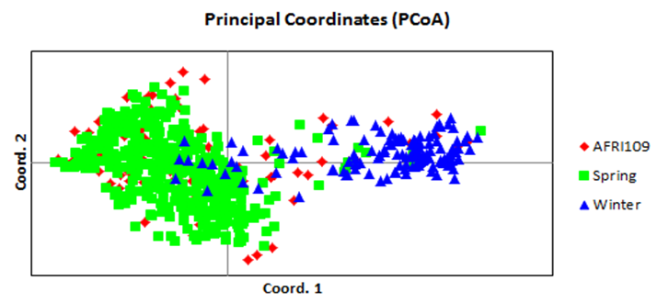
Spring and Winter are definitely different:

Slide 19

Model-based analysis reveals structure of 17 different breeding programs / regions
Model: K=10 (colours show % of diagnostic alleles)
NDSU
Winn
Ottawa
Texas
Nord
Idaho

Slide 20
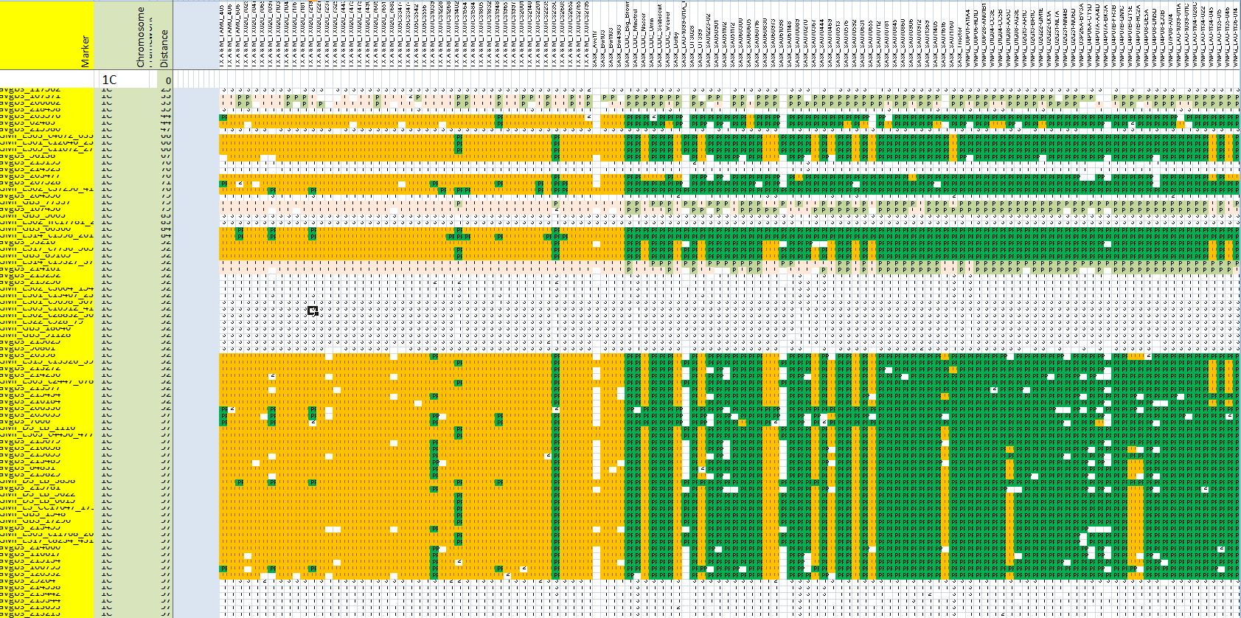
Why does structure matter ?
“Winter” alleles
“Spring” alleles
Texas varieties
Northern Prairie Varieties
SNP and GBS markers

Slide 21
CORE Concept Summary
Representative DNA Sequence
Diverse germplasm
Discover genetic differences among oat varieties
Mapping germplasm
Marker assays
+ gene database
Breeder Germplasm
Consensus map
Genotype / Trait database
Evaluate field & seed Traits
Analyse population structure
Associate markers with traits
Breeding assays + genomic selection

Slide 22
Genome Wide Association Mapping (GWAS)
Concept is simple:
  which markers are correlated with a trait
  which varieties have the good alleles at those loci
Hundreds of good predictions from CORE
Specialists are refining these predictions
  Correlate with known disease resistance
  Genotype x Environment interaction
  Explore candidate genes

Slide 23
Genomic selection
Give every marker a weight
Advantages
  Simple: one abstraction, one inference: “best breeding value”
  Less likely to be influenced by structure ?
Drawbacks
  Tends to improve within a good population
  Not good at introducing new alleles
  Artifacts can go un-noticed

Slide 24
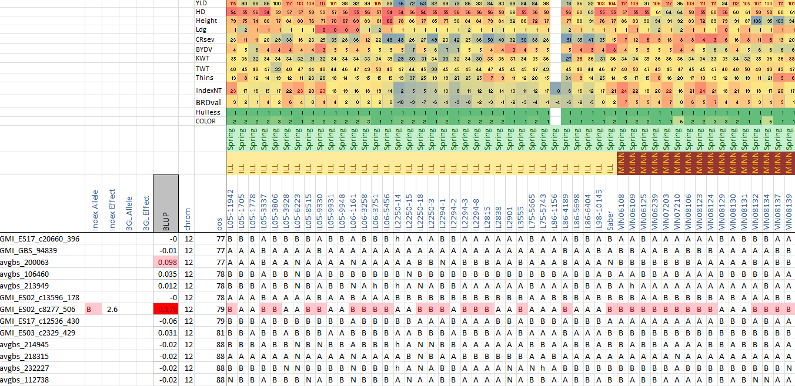
Integrating multiple inferences

Slide 25
Conclusions
CORE data is a rich foundation
  Already supporting new oat science
  Moving toward a “universal” public oat database
  Now mobilizing to support molecular breeding
Challenges:
  Develop “comfort level” with big-data and abstractions
  Build smart-tools into database (“automated abstractions”)
  Commit to continue sharing (experience, data and germplasm)
  Predict crosses, not just selections
  Use tools to access wild relatives

